Slide 1

CLASSIFICATION OF MYOCARDIAL INFARCTION
Presented by
Project 68 Team number 7
Team members:
Amit Srivastava
Dhanush Kumar M
Harshitha J
Mayur Bharatbhai Vaishnav
Aditya Rajendra Dusane
Mentor:
Venkata Mukesh

Slide 2
Business Objective:
To Classify the Lethal outcome (cause) (LET_IS)(Y variable) using the given dataset.

Slide 3
PROJECT ARCHITECTURE
Data collection
Model building
Model Evaluation
Data cleaning
Feature extraction
Deployment
EDA
Data Preprocessing

Slide 4
DATA SET DETAILS
Sl.no | Attributes | Description
1. | Total Number of variables | 124
2. | Number of observations | 1700
3. | Variable types | Float- 110 Integer-14
4. | Duplicate rows | 0

Slide 5
Exploratory Data Analysis (EDA)

Slide 6
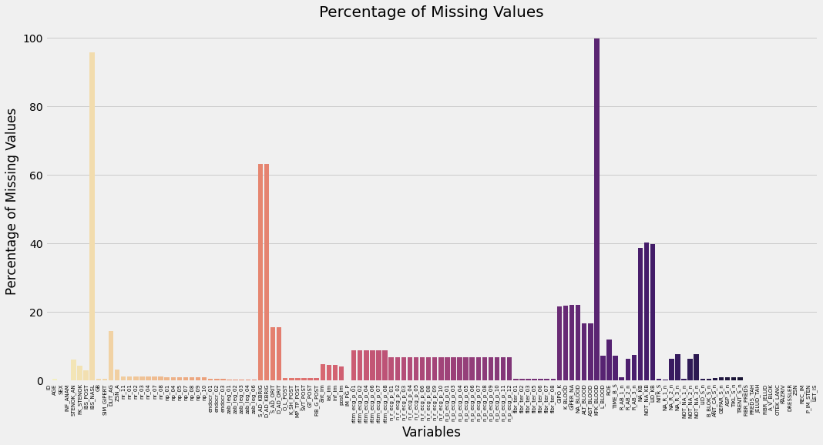
Checking for Percentage of missing values .

Slide 7
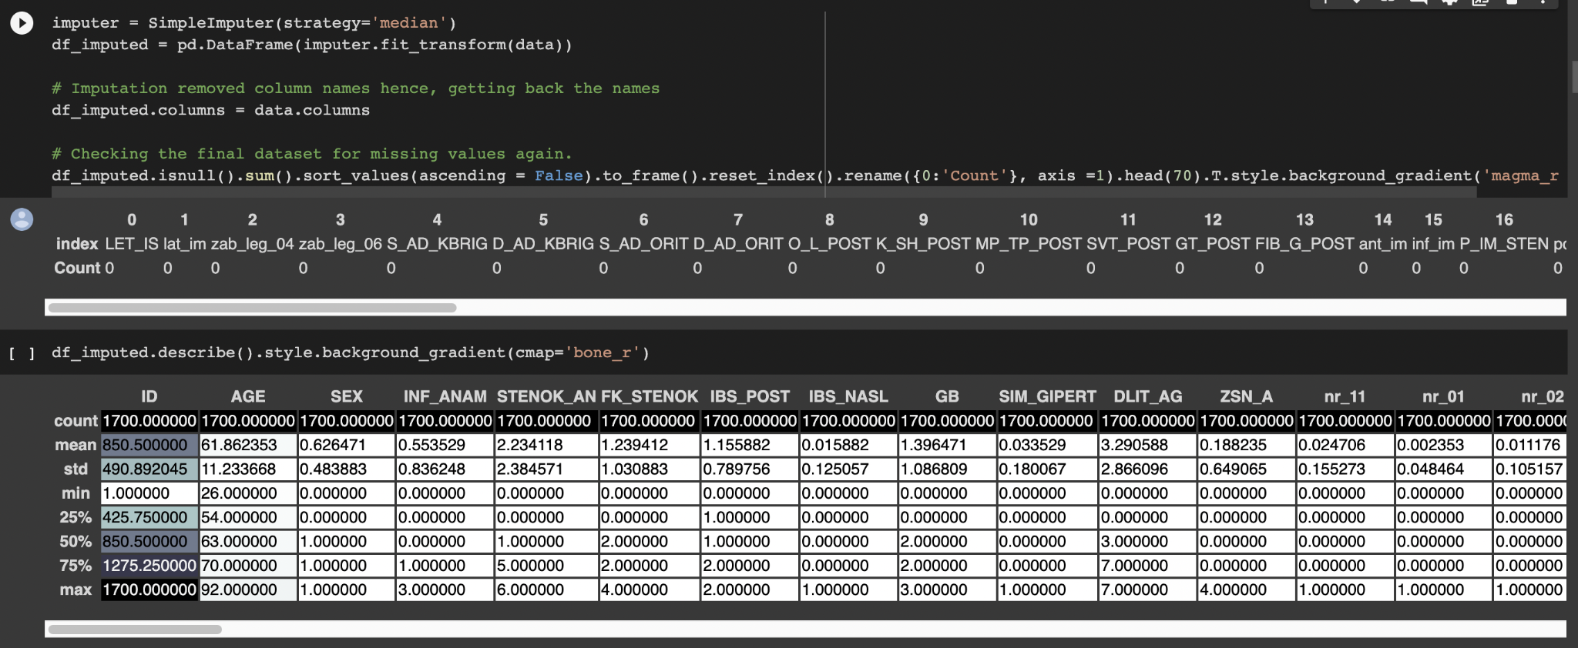
Imputation and Validation
We dropped ID column as it was insignificant.

Slide 8
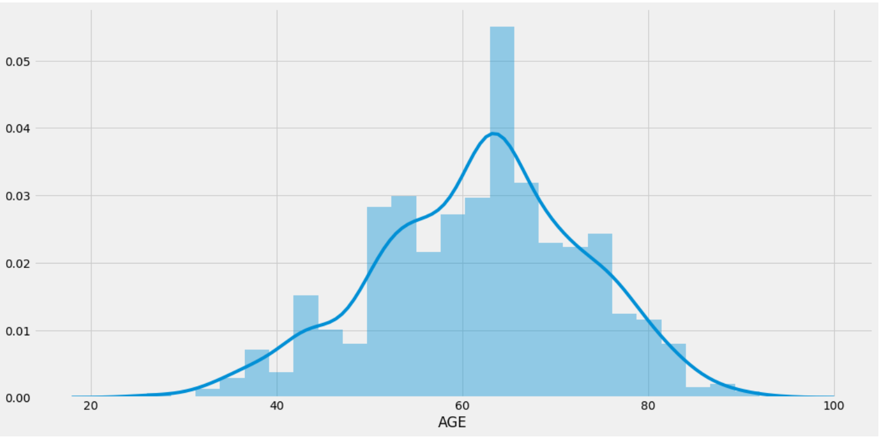
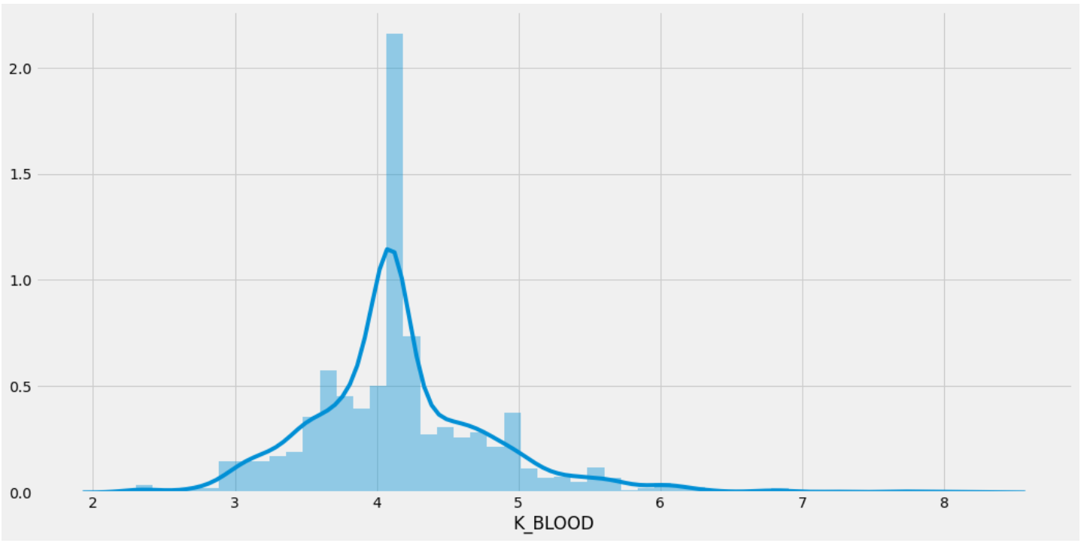
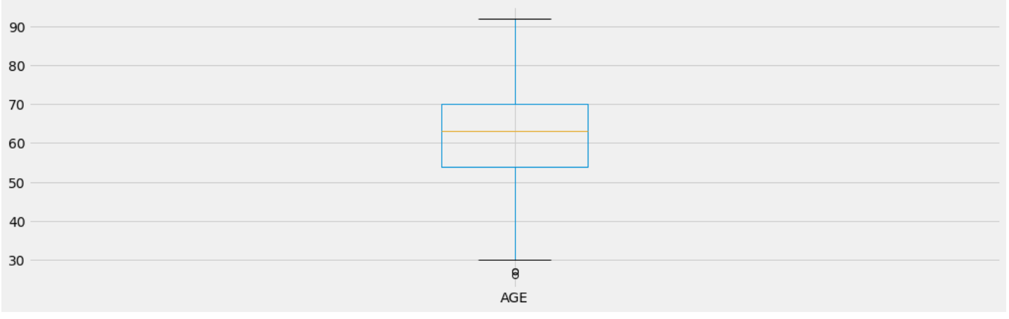
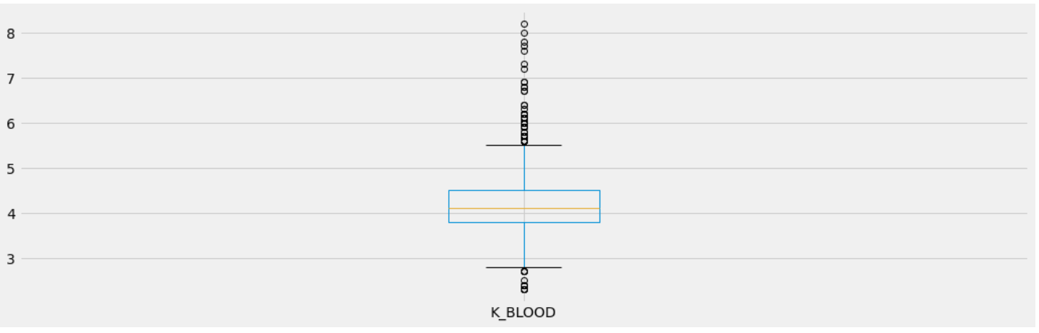
Independent Variable : Numerical

Slide 9
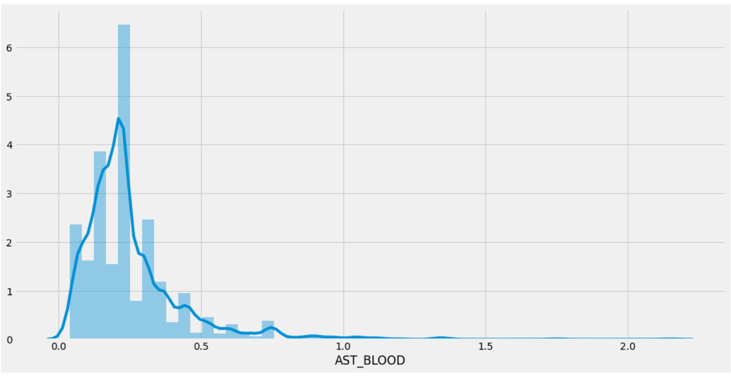
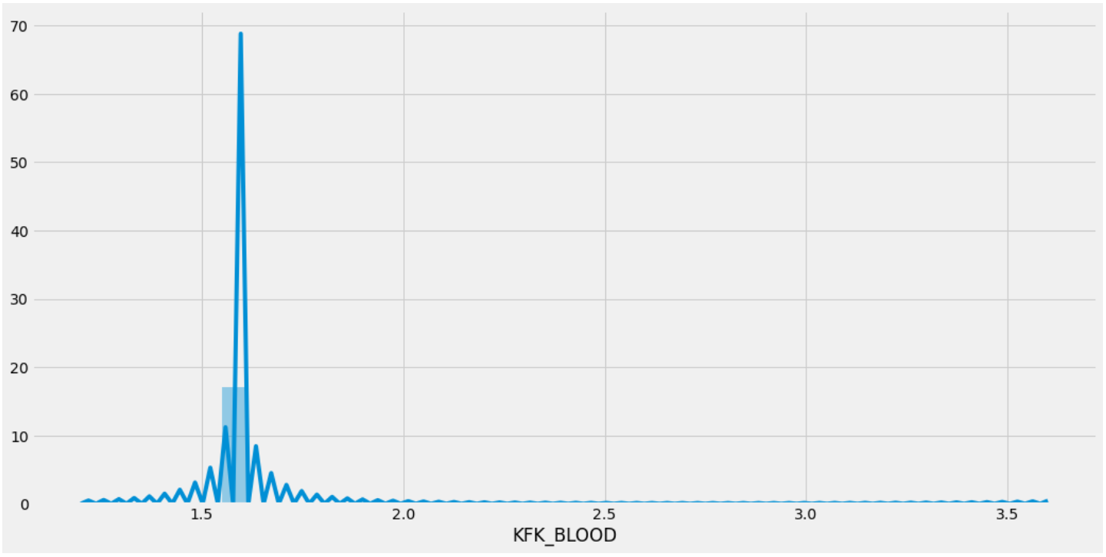
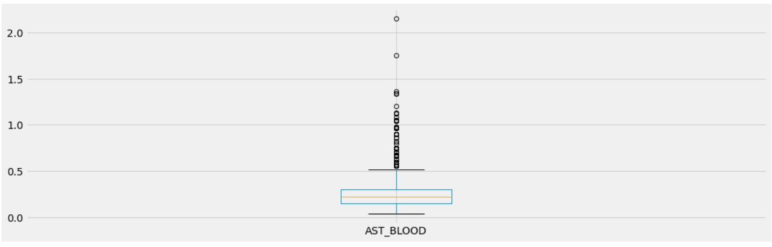
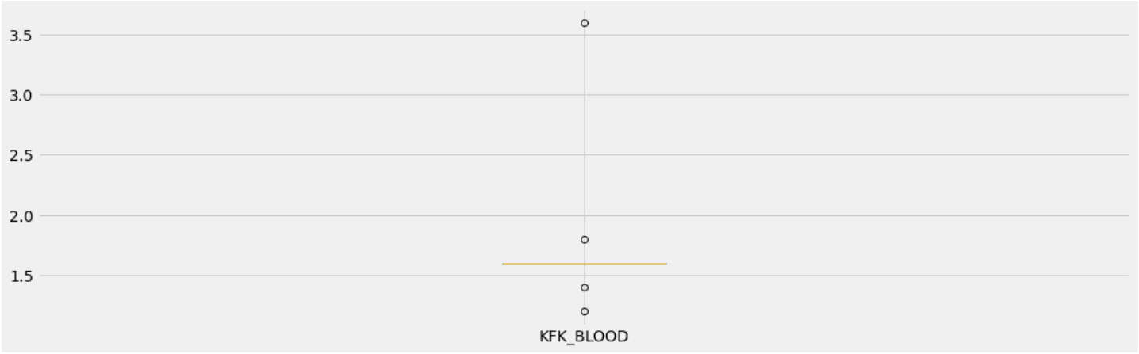

Slide 10
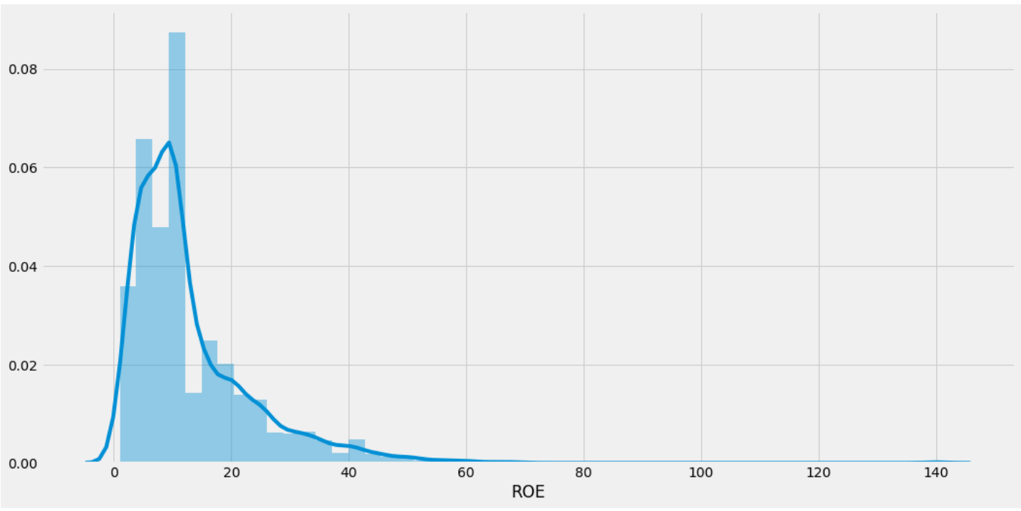
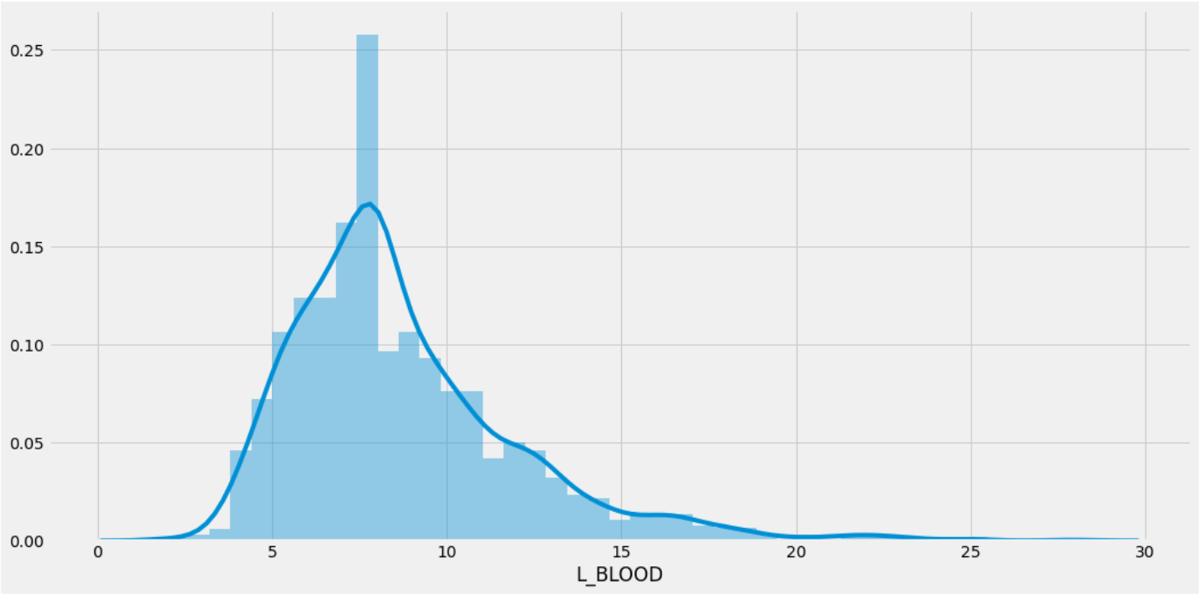
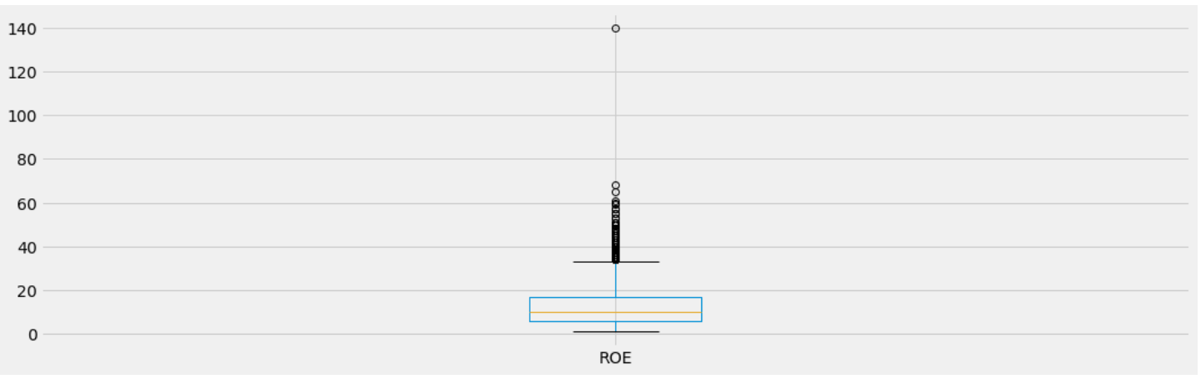
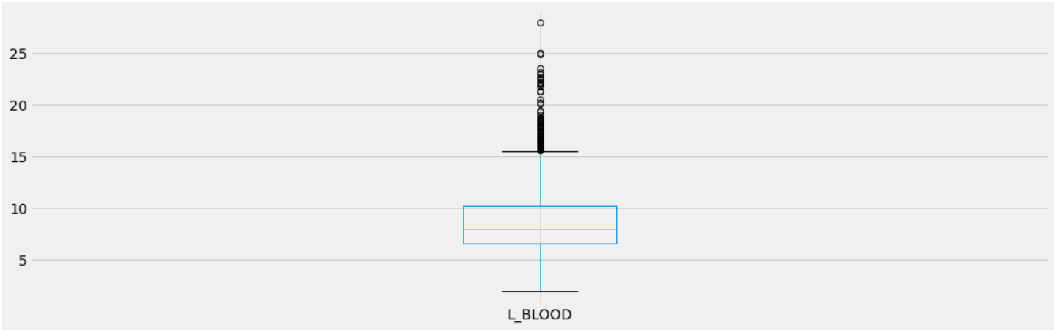

Slide 11
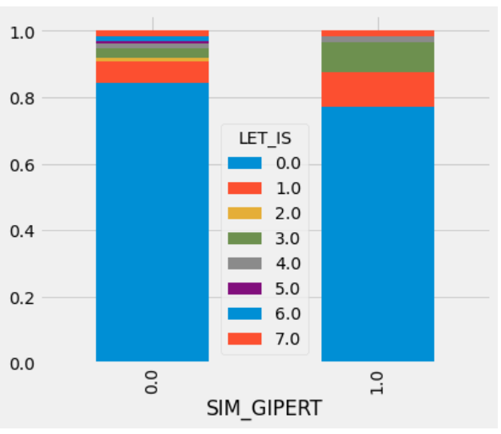
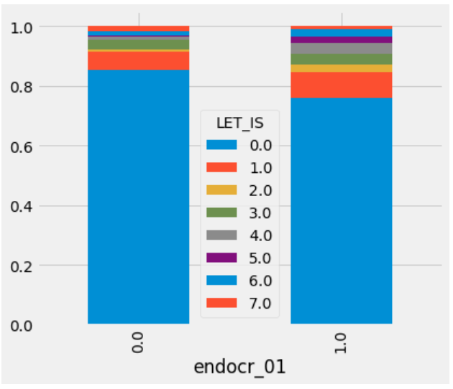
Bivariate Analysis
Categorical Independent Variable vs Target Variable

Slide 12
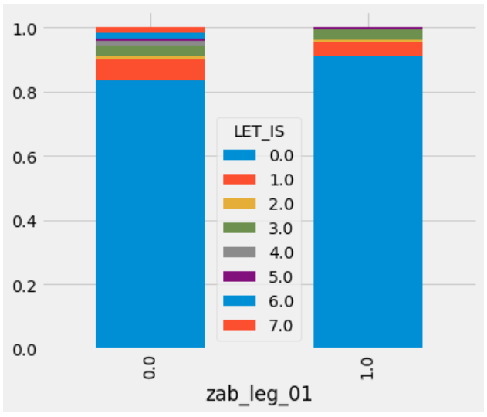
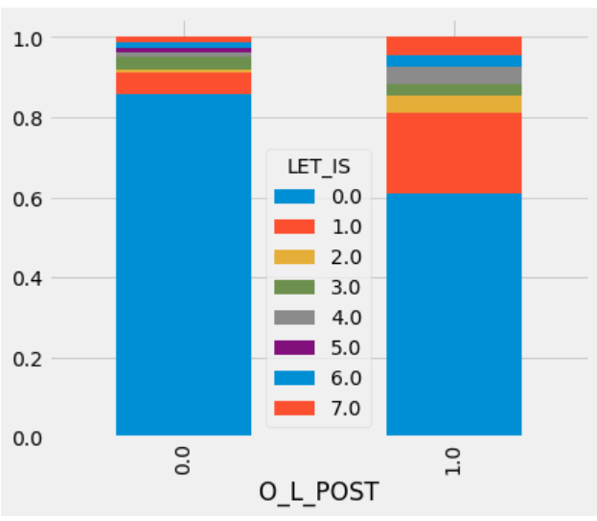
Bivariate Analysis
Categorical Independent Variable vs Target Variable

Slide 13
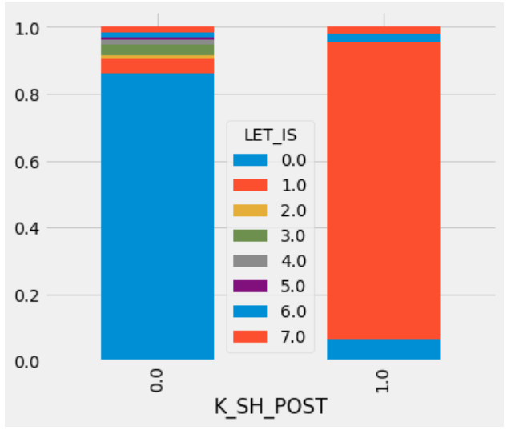
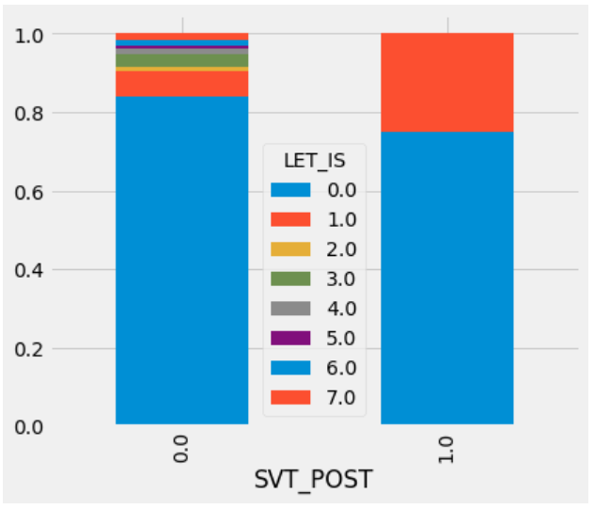
Bivariate Analysis
Categorical Independent Variable vs Target Variable

Slide 14
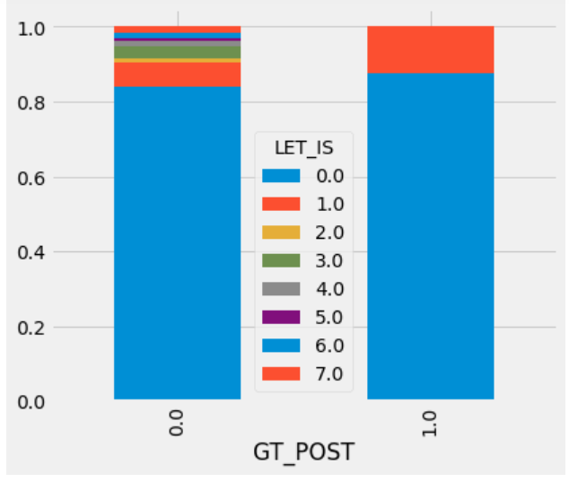
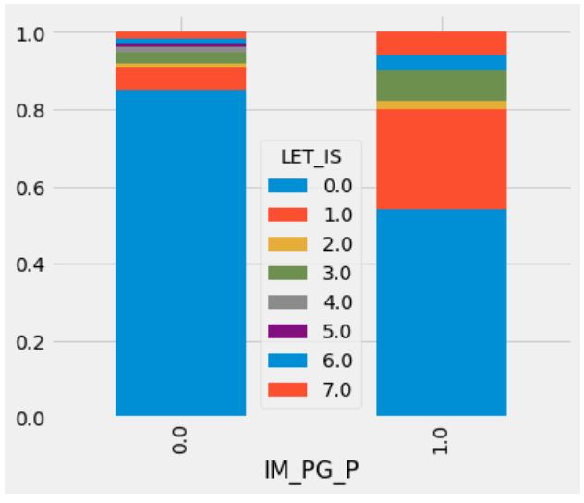
Bivariate Analysis
Categorical Independent Variable vs Target Variable

Slide 15
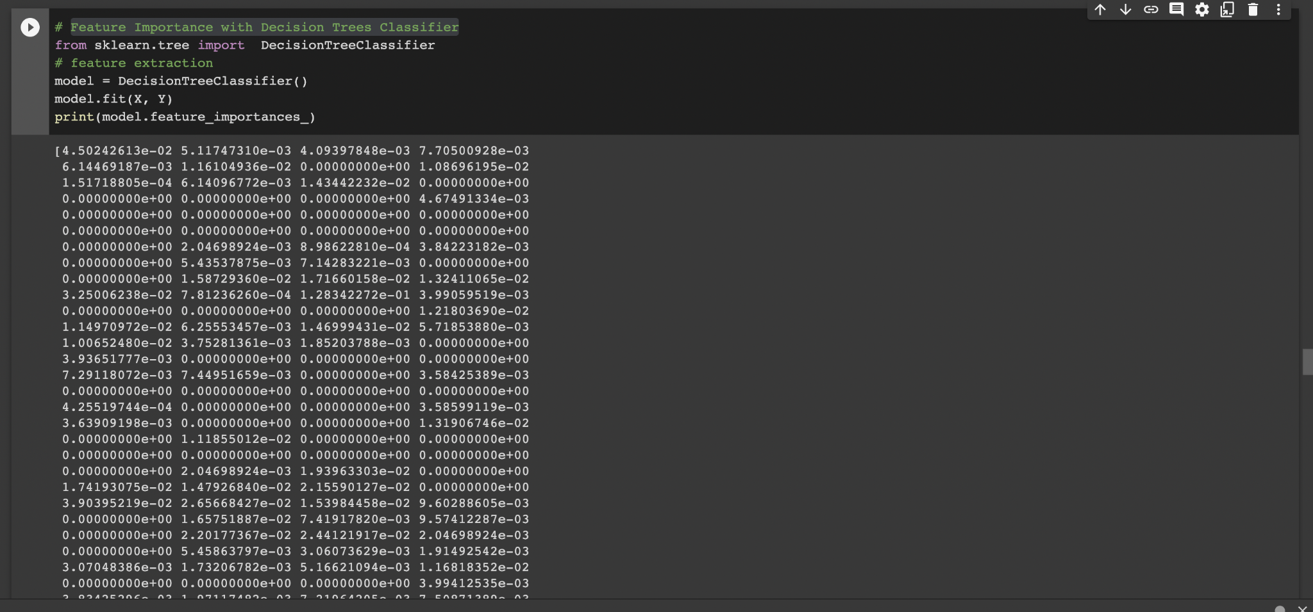
Feature Importance with Decision Trees Classifier

Slide 16
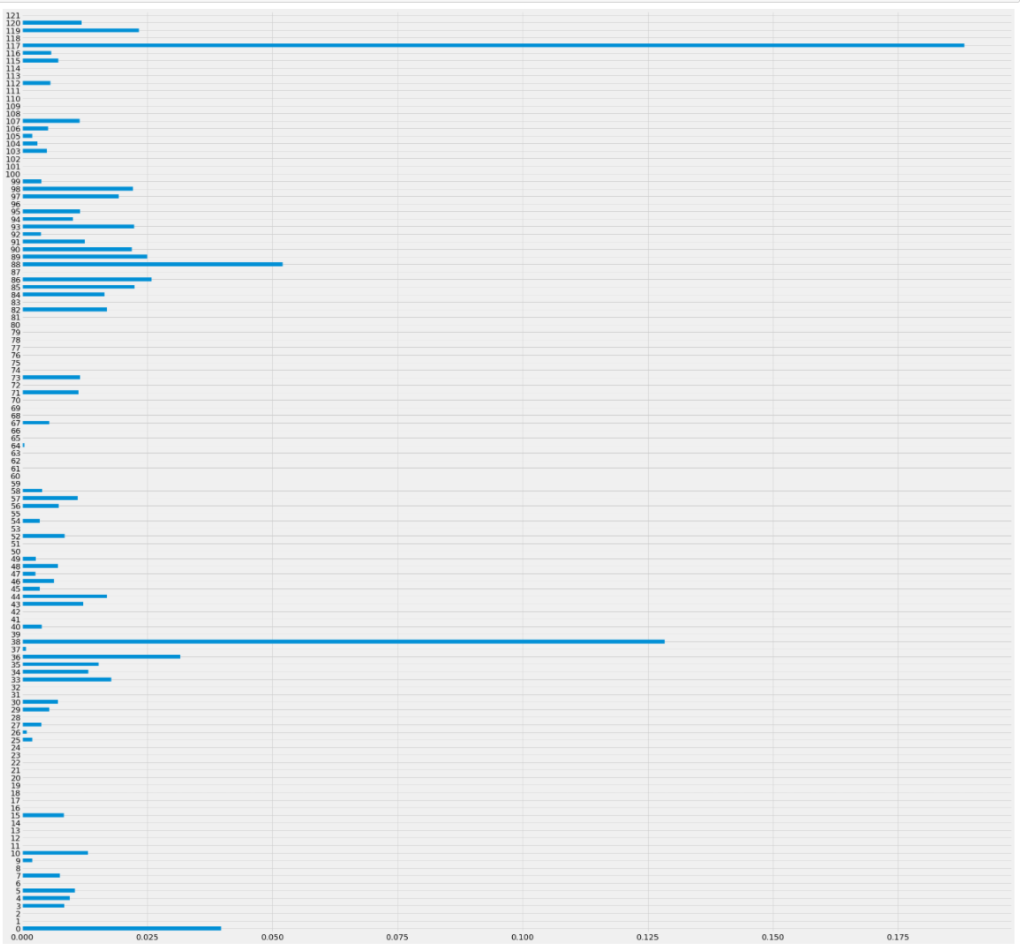
Feature Importance with Decision Trees Classifier

Slide 17
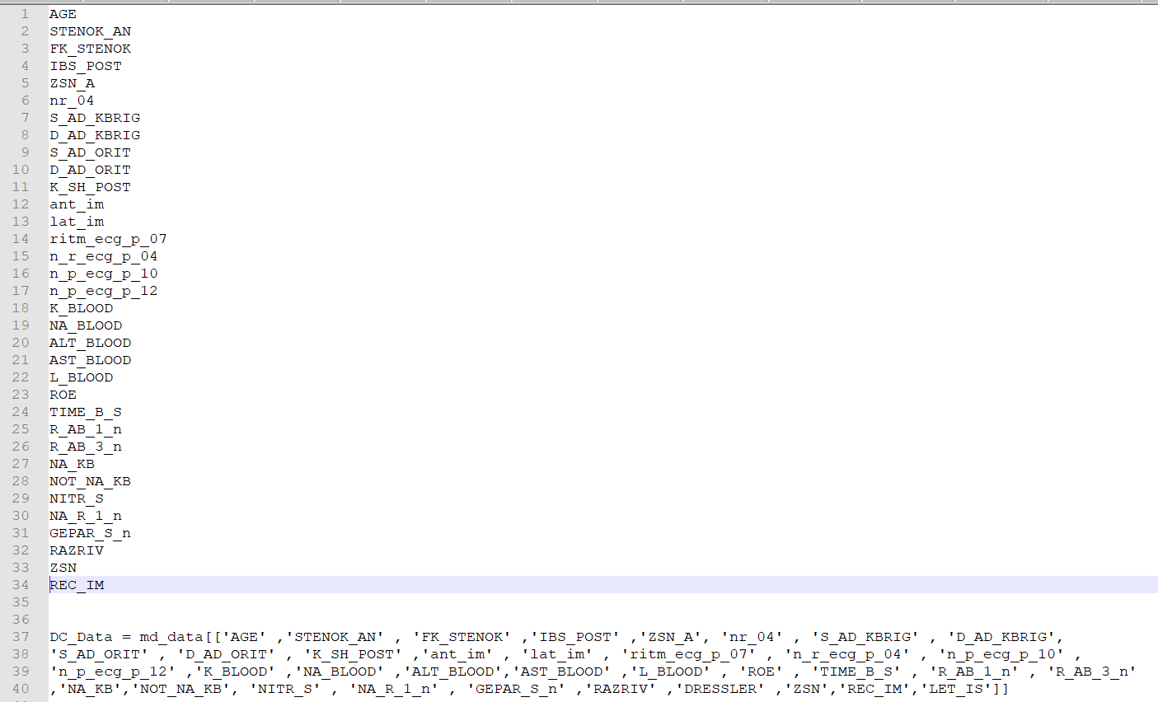
Feature Column with Decision Trees Classifier

Slide 18
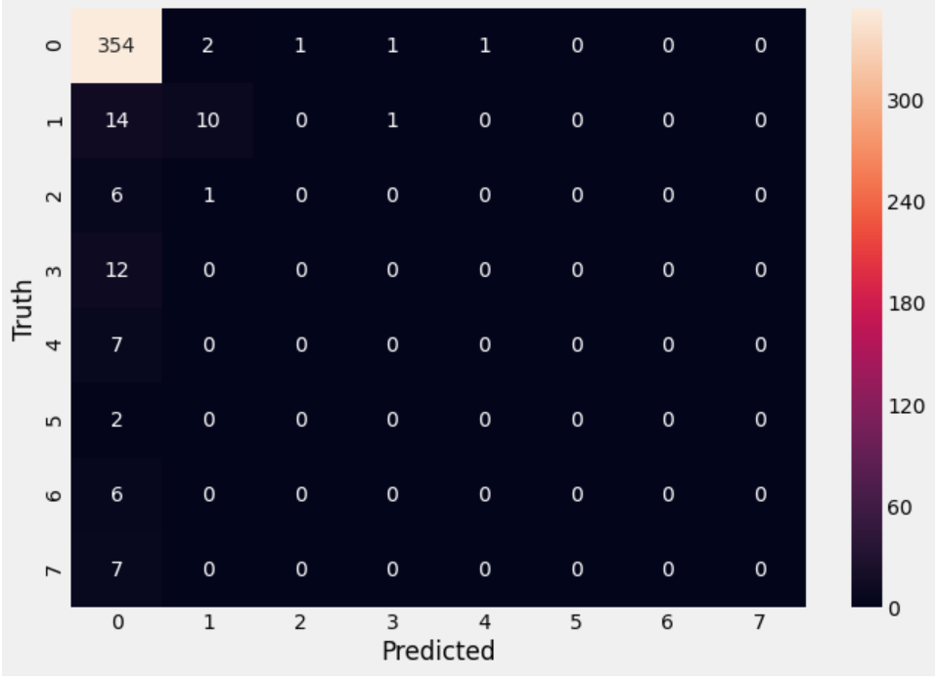
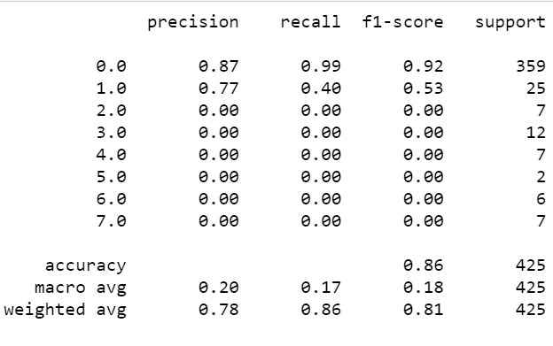
1. Logistic Regression
Train accuracy for Logistics Regression: 0.855
Test accuracy for Logistics Regression: 0.856
Confusion Matrix for the model accuracy
Classification report

Slide 19
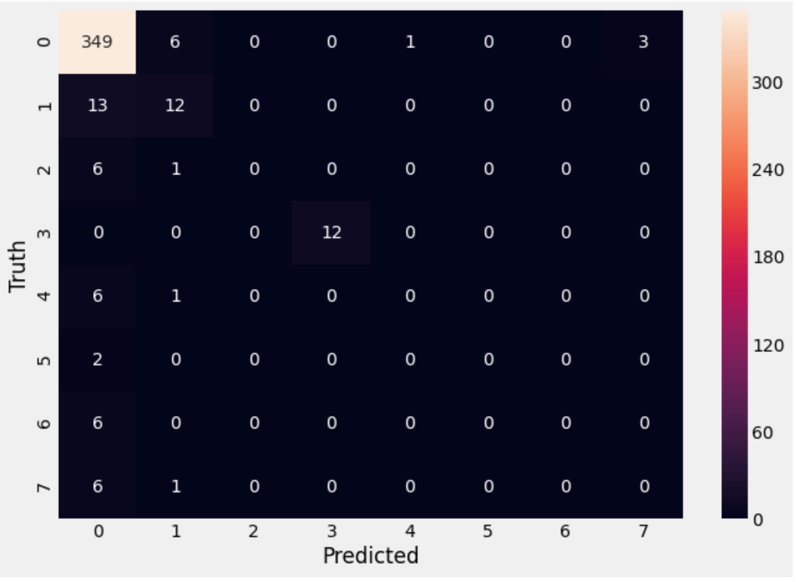
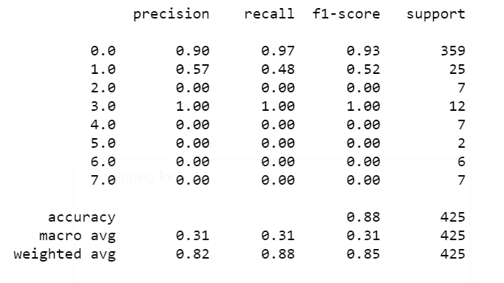
2. Bagging Classifier
Train accuracy : 0.891
Test accuracy : 0.878
Confusion Matrix for the model accuracy
Classification report

Slide 20
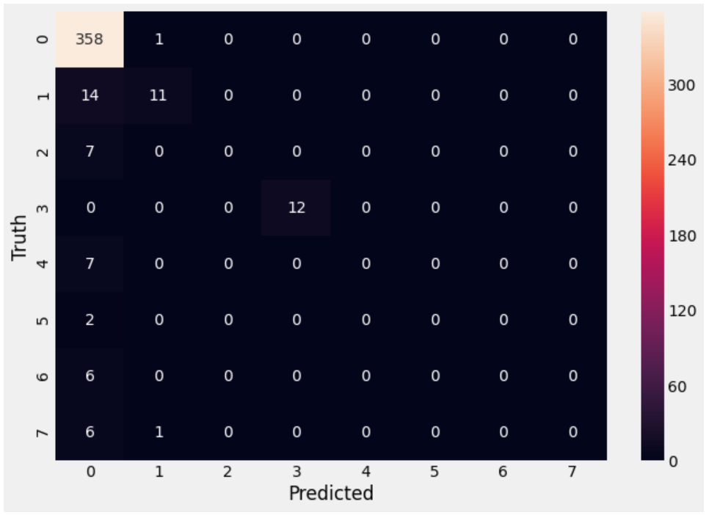
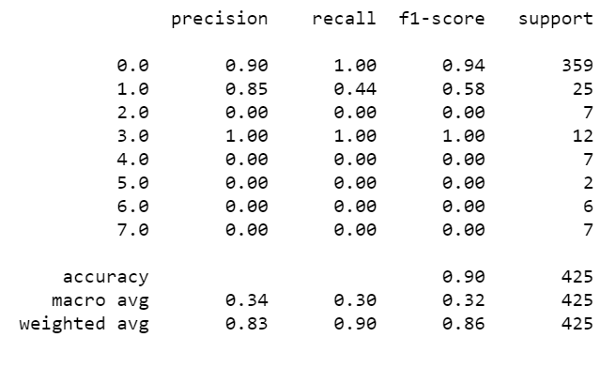
3. Random Forest Classification
Train accuracy : 0.893
Test accuracy : 0.896
Confusion Matrix for the model accuracy
Classification report

Slide 21
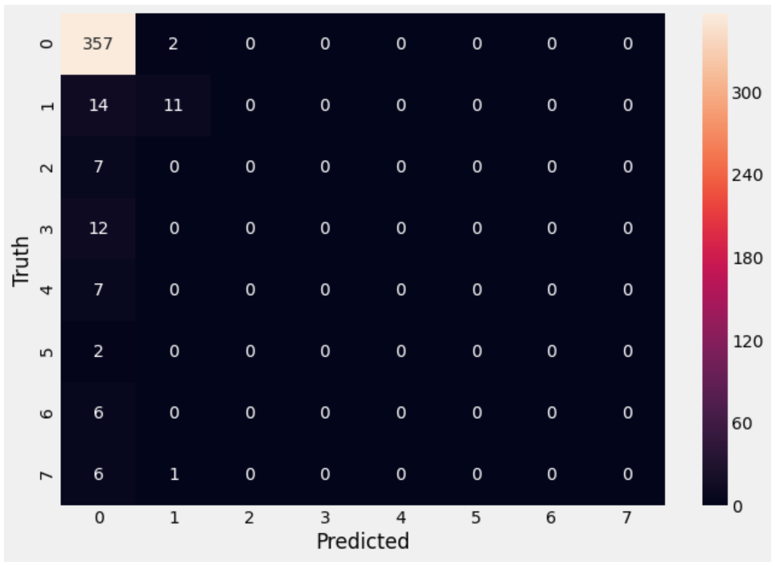
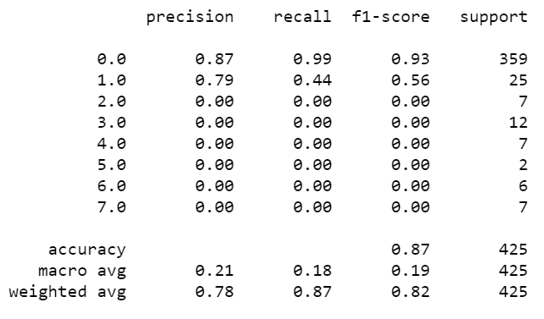
4. KNeighbors Classifier
Train accuracy: 0.850
Test accuracy : 0.866
Confusion Matrix for the model accuracy
Classification report

Slide 22

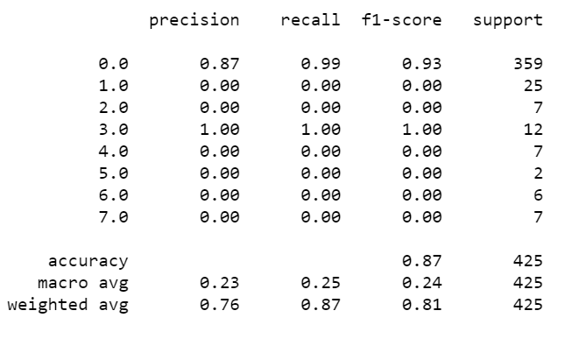
5. AdaBoost Classification
Train accuracy: 0.864
Test accuracy: 0.866
Confusion Matrix for the model accuracy
Classification report

Slide 23
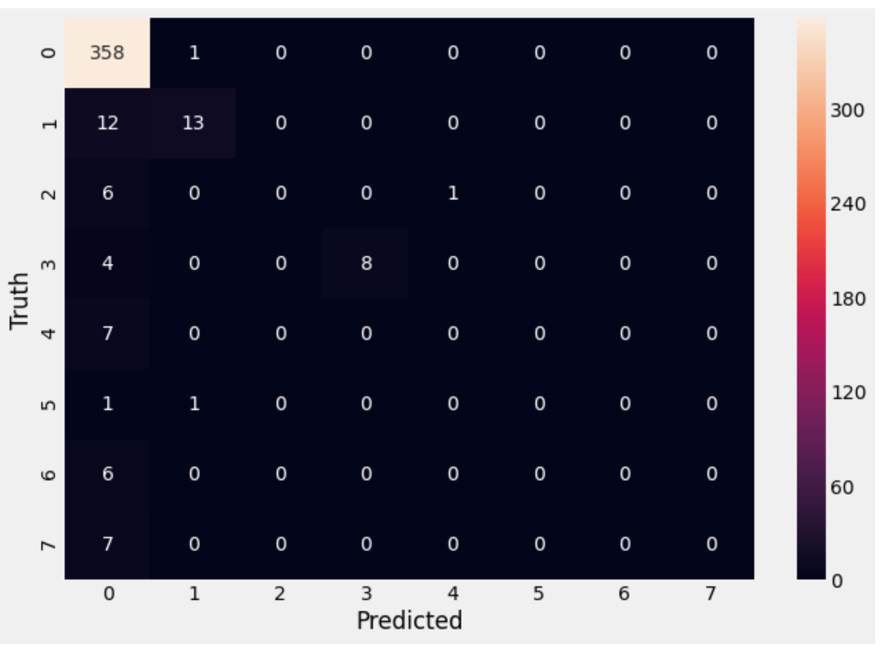
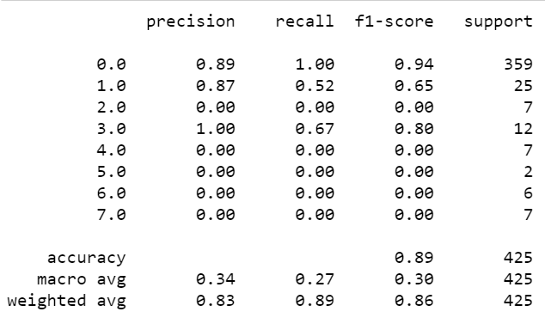
6. Stacking Ensemble Classification
Train accuracy: 0.884
Test accuracy: 0.891
Confusion Matrix for the model accuracy
Classification report

Slide 24
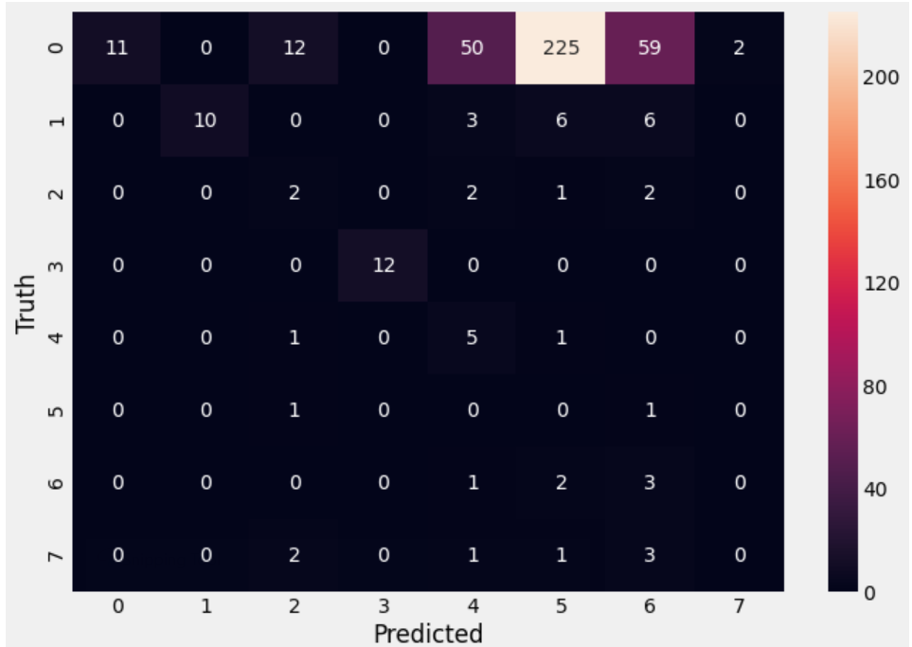
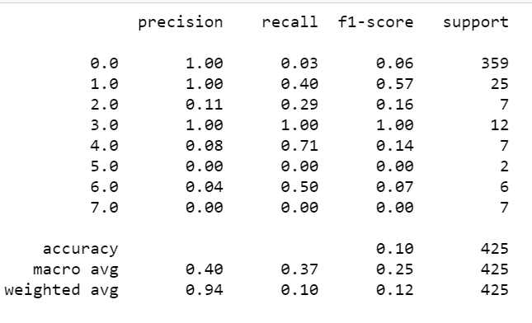
7. Naive Bayes Classifier
Train accuracy: 0.883
Test accuracy: 0.101
Confusion Matrix for the model accuracy
Classification report

Slide 25

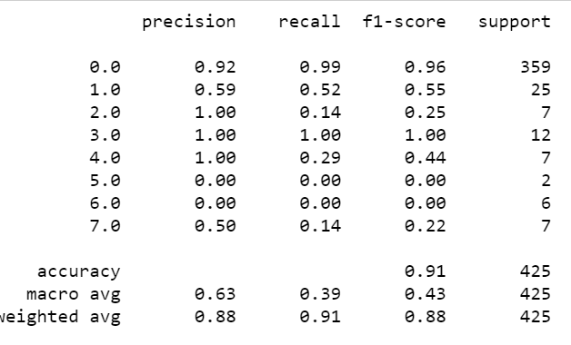
8. XG Boost Classifier
Train accuracy: 0.883
Test accuracy: 0.893
Confusion Matrix for the model accuracy
Classification report

Slide 26
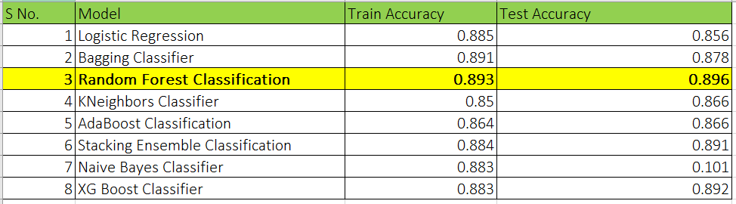
Model Accuracy Comparison

Slide 27
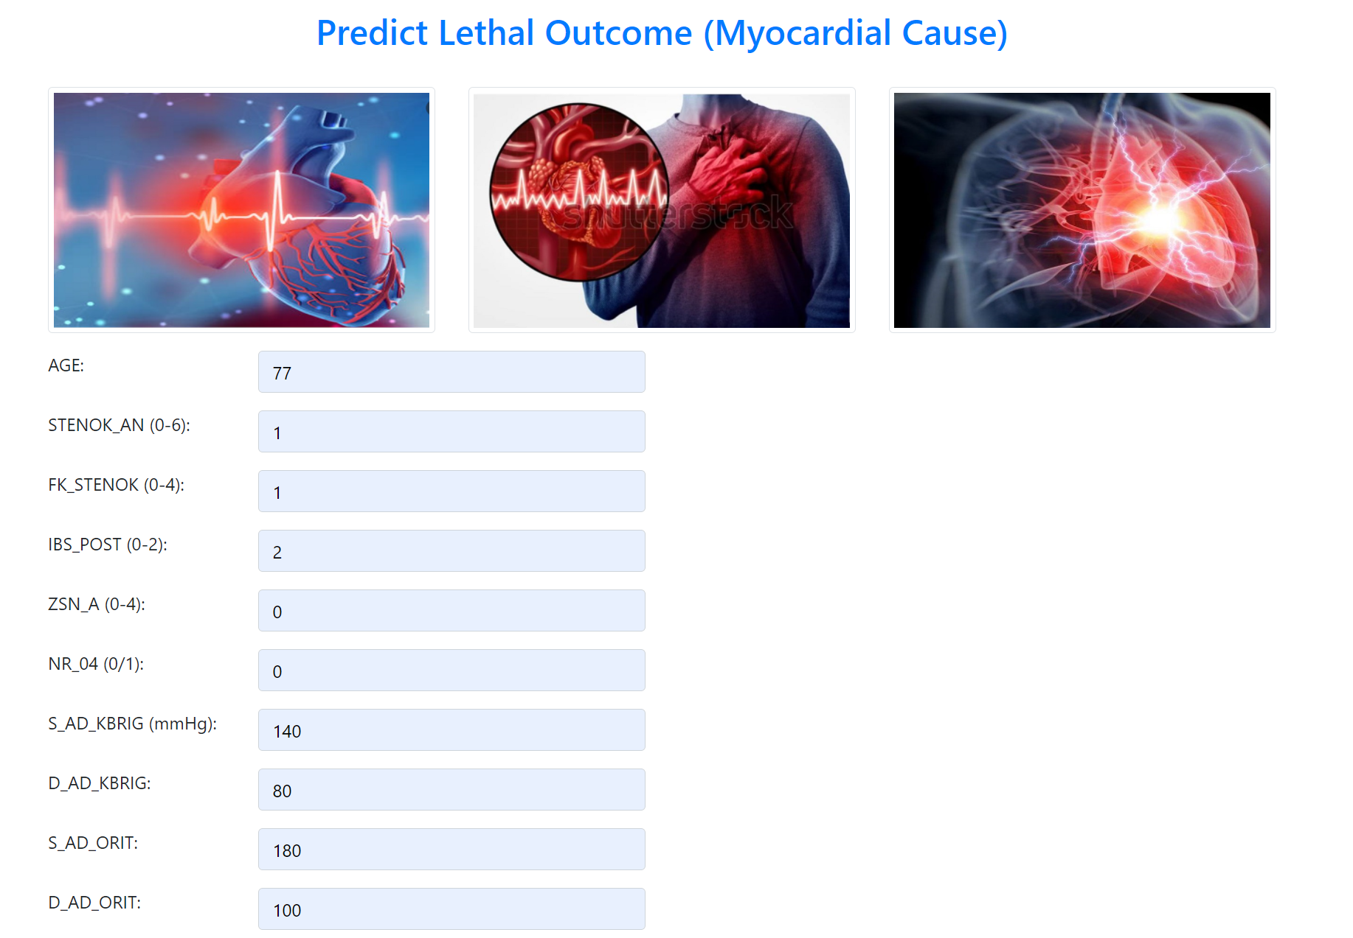
Model Deployment on Web and Testing

Slide 28
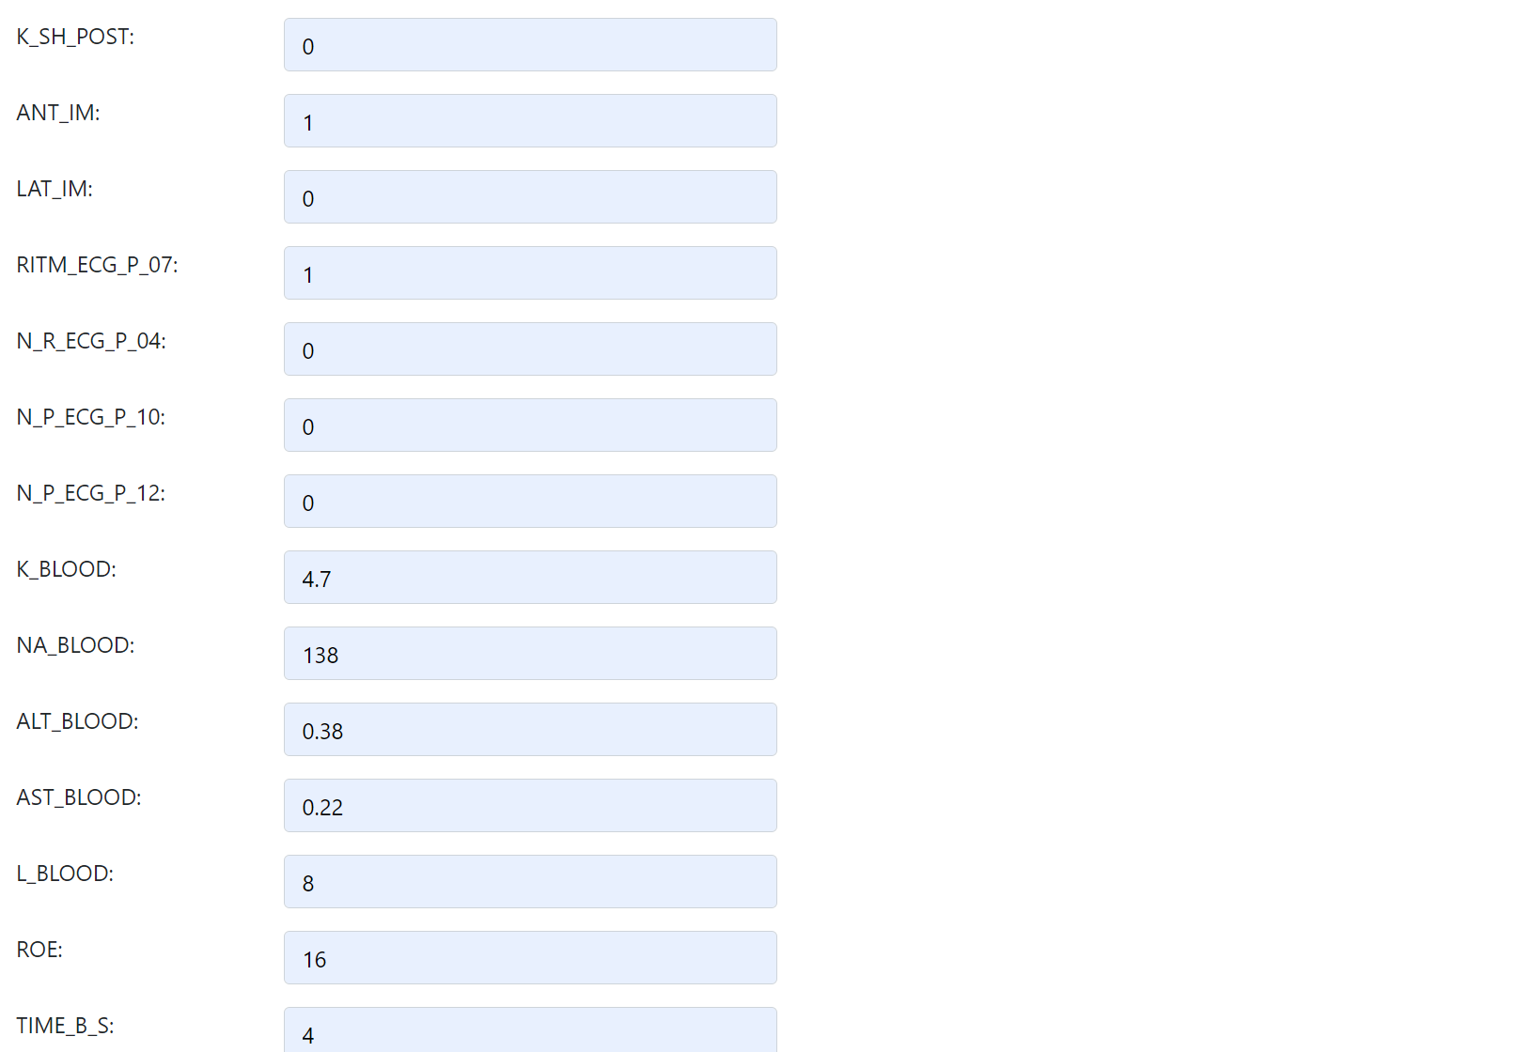

Slide 29
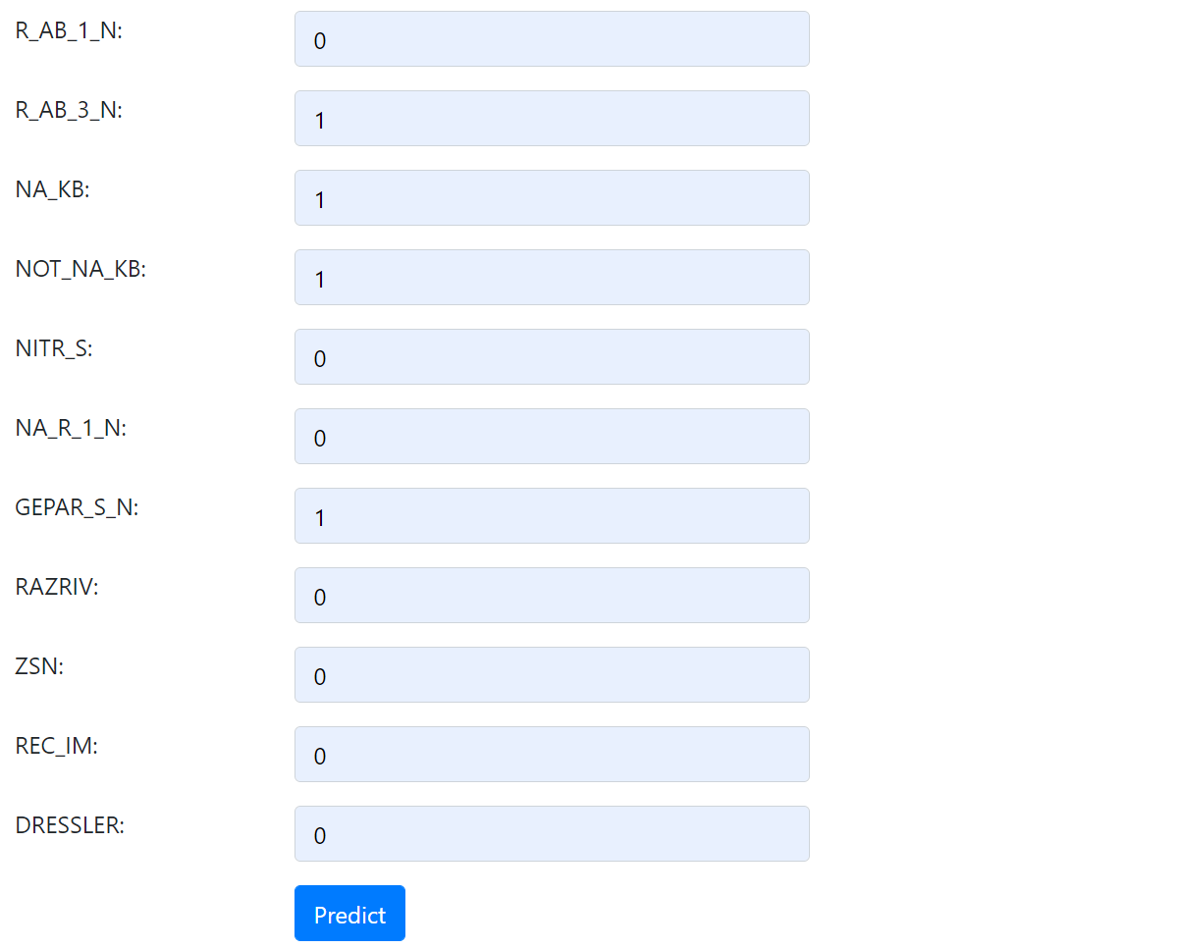

Slide 30

Model Prediction:

Slide 31
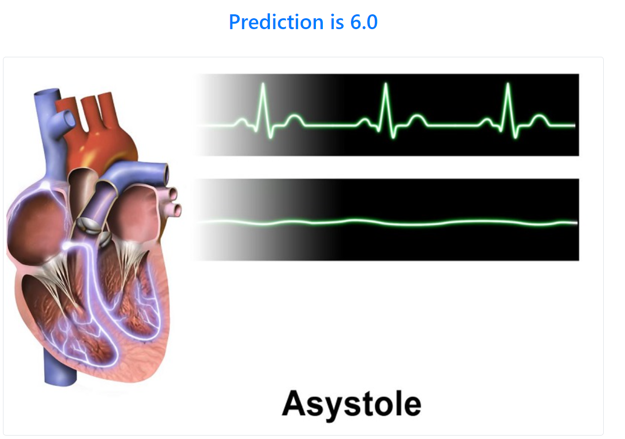
Model Prediction:

Slide 32
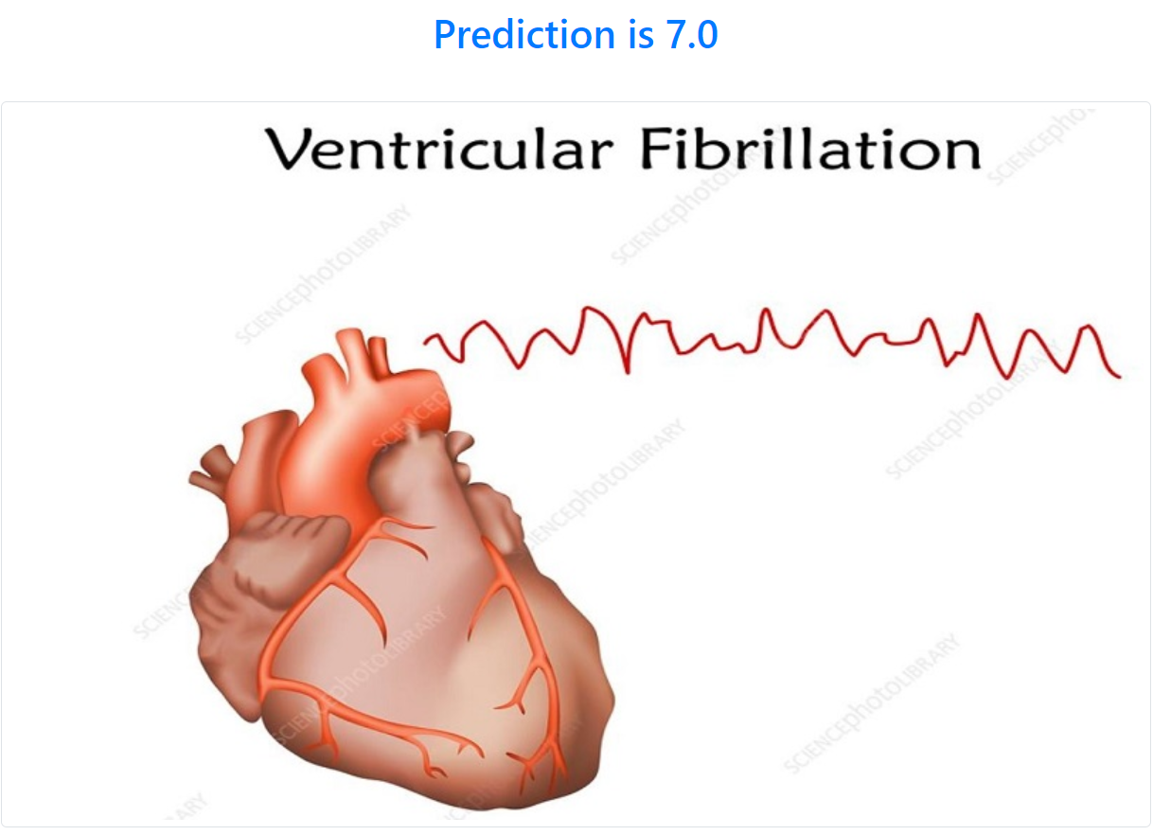
Model Prediction:

Slide 33
Thank You

